Slide 1
Summary of Advice for Aucklanders
The Live Lightly hub, www.livelightly.nz identifies a range of doable actions across six key climate action themes: Eat, Move, Shop, Energy, Grow and Talk. Each category promotes a series of actions that significantly reduce carbon emissions, which can be adopted into your daily routine. Take an online pledge, check out stories of change from Aucklanders like you or sign up for our newsletter updates.
Connect with us on Facebook facebook.com/livelightlyakl or contact us at hello@livelightly.nz
FutureFit – www.futurefit.nz discover your personal impact on the planet using this online tool and take action to reduce it (available late 2018).
Find your local community group – there are so many active groups in Auckland to get involved with and to learn more about how you can live lightly and make a difference. livelightly.nz/in-your-community
Visit https://www.aucklandcouncil.govt.nz/environment/sustainability-eco-design/Pages/get-advice-make-your-home-healthy-energy-efficient.aspx and www.energywise.govt.nz/at-home/ to find out how to reduce your energy bills, get an in home assessment, borrow a HEATkit or access loans to make your home warm and dry.
Visit https://at.govt.nz/ to find out how you can plan your journeys, access information, maps and Apps to make your commute easier, by carpooling, cycling, using public transport or flexiworking.
Visit makethemostofwaste.co.nz for up to date information on rubbish and recycling services, community recycling centres, videos, translations, online recycling search and quiz.

Slide 2
Summary of Support for Communities
Live Lightly Community Kete – livelightly.nz/resources/communitykete. This is a rich, evolving online set of resources designed to empower community groups and local activators to embed sustainable behaviors in daily lifestyles. It includes inspirational speakers and movies; access to funding and assistance for community-led initiatives with low carbon outcomes; opportunities for skill shares and networking hui; and hands-on resources and activities that groups can use to engage their community to act.
Community Activator training and support. Our Low Carbon Specialist is available to work with your group to ensure Live Lightly actions and resources are available to residents in your community. Contact hello@livelightly.nz to make an enquiry.
Grants and funding opportunities are available for community-led initiatives with low carbon outcomes. We’ve collated a list of council and non-profit community funds, dates and contacts: livelightly.nz/media/1369/community-toolkit-how-to-fund-your-project-final.pdf
Sustainable Schools livelightly.nz/at-school council provides support for primary and secondary schools and early childhood centres through Sustainable Schools advisors and the delivering the Enviroschools programme– contact sustainableschools@aucklandcouncil.govt.nz
Advice and mentoring for small businesses and social enterprises is available through Co-starters for a Cause

Slide 3
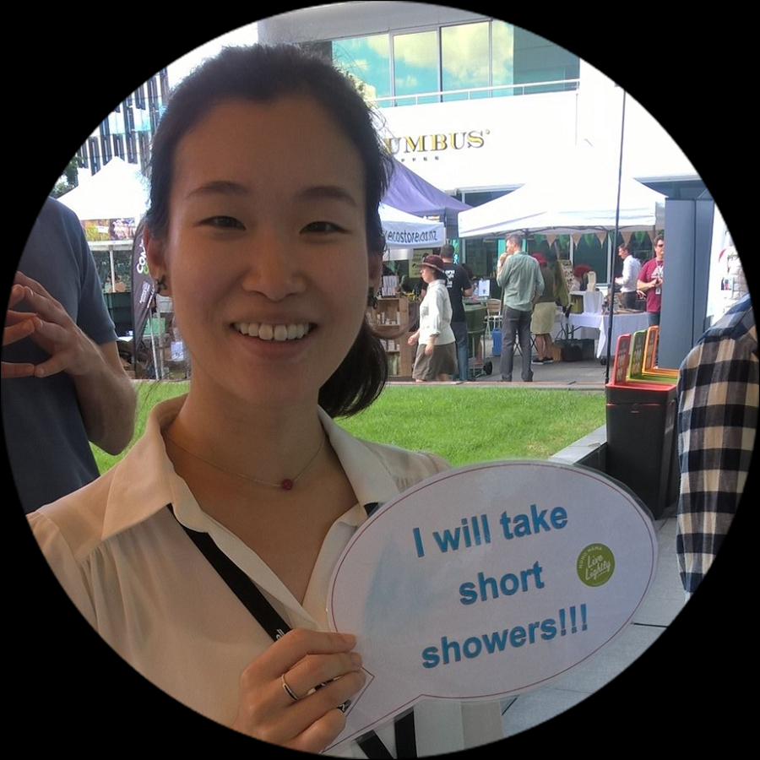
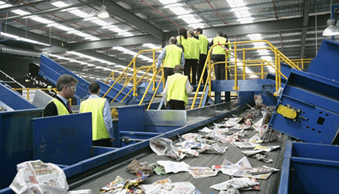
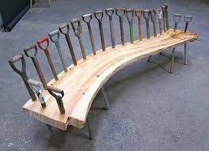
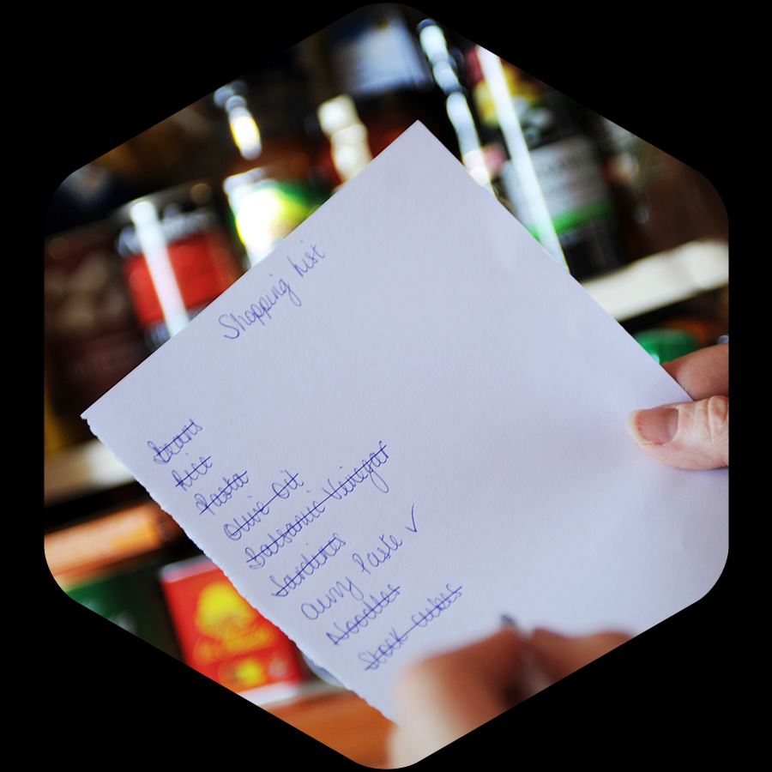
Summary of Support for Communities
Low Carbon Networks are a great way to connect with like-minded people and take local action. There are currently local board funded networks in Waitemata, Whau and Puketepapa. See https://www.facebook.com/aucklandlowcarbon/ to join or find out more.
Visit the Zero Waste Zone and tour an operating transfer station to find out ways to reduce waste and consider what happens to the things you buy. Contact 09 3010101 for more information or to book a visit
Take a free visit the VISY materials recovery facility to see what happens to what you put into your recycle bin. Minimum 15 people per tour. Book via recyclingvisits@visy.co.nz
Make sure your friends, whanau and neighbours know how they can save on power bills and have a warm and dry home - you could gather a group to try these together. An Eco design Advisor can come to your home to give tips on ways to have a more sustainable home. Book out a HEATkit from your local library to see where you could make improvements to have a warmer, drier home, like adding draught stoppers or curtains. Investigate Retrofit your Home loans offered by council to fund more expensive purchases like efficient heating or insulation.
Is your group looking for items to reuse and upcycle? Check out your closest Community Recycling Centre or register to access materials from councils Inorganic Collection warehouse.
Book into a Waste Free Parenting workshop near you or check out Kate’s product guide online.
See how you can save by wasting less food. Share tasty recipes, access easy choice meal planners or sign-up for free online coaching at www.lovefoodhatewaste.co.nz or connect with the Kai Auckland movement.
Find workshops, videos and hands-on advice at www.compostcollective.org.nz on composting, worm farming and using bokashi at home, as well as community gardens and growing food. You can even host a neighbourhood compost party!
Green up your local neighbourhood - volunteer, attend, or offer to run planting days or workshops with Ecomatters, Kaipatiki Project or Manukau Beautification Trust

